Slide 1
Monitoring of process contaminants in real time using the fluorescence-based tool Fluoralys for a rapid diagnosis of product and process safety
Notes:
1

Slide 2
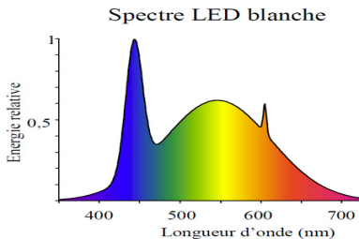
Scheme of the optical design and software
FLUORALYS
Embedded Electronic
LED 4
LED 3
LED 2
LED 1
Adapt.
CCD Sensor
Diffraction gratings
« Stylus » probe
4 excitation fibers.
1 Read fiber
Spectral information
Fluorescences.
4LED = 4 emission spectra
2

Slide 3
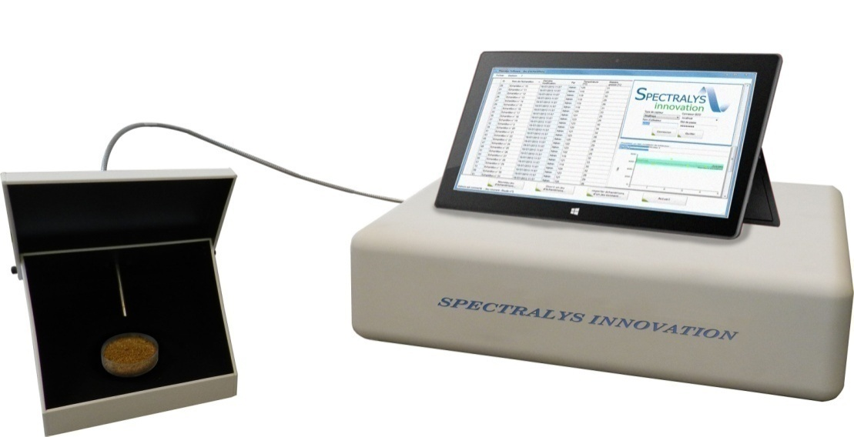
Scheme of the optical design and software
FLUORALYS
SOFTWARE
Measurement controle
Analysis of Fluorescence information
Application of calibration models.
Calculation of means and std
Database
Monitoring the control map.
3
Notes:
3

Slide 4
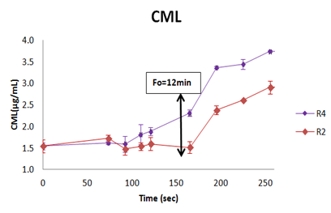
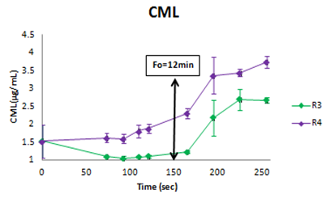
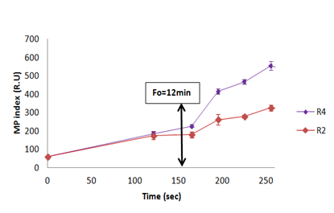
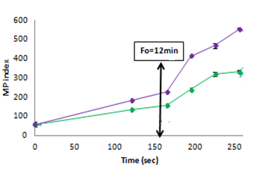
Real time diagnosis on recipe sensitive to heat damage
CML
DHA + iron
DHA - iron
DHA + lactose + vitC
DHA + maltodextrin
Fluoralys
DHA + iron
DHA - iron
DHA + lactose + vitC
DHA + maltodextrin

Slide 5
Impact of storage
Accelerated for 60 days at 50°
Celsius
Formula A
Formula B

Slide 6
Infant formula heat process control using FLUORALYS
Ohmic heating process
In line
Sampling
At line
In line
At line

Slide 7
Rapid diagnosis on baby food quality using FLUORALYS
Real time comparison of 2 technologies
Impact of storage
Furan
Fluoralys
Furan
Retorting
Furan
Fluoralys
Fluoralys
Ohmic heating

Slide 8
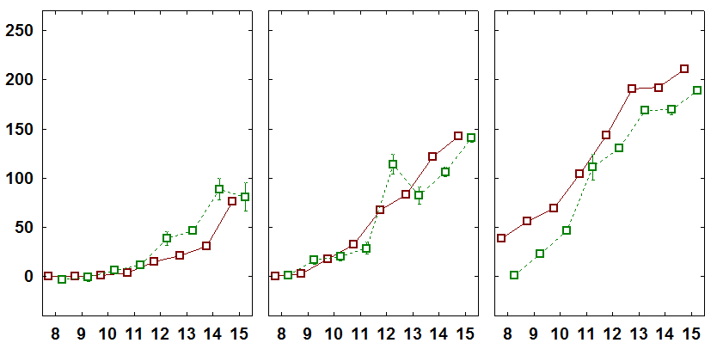
Monitoring acrylamide in biscuits using FLUORALYS
At line
In line
180°C
190°C
200°C
Acrylamide (µg/kg)
Acrylamide (µg/kg)
Data measured Data predicted
FLUORALYS
Probe
Probe holder

Slide 9
Industrial monitoring of acrylamide in biscuits in a multicriteria approach
Monitoring of acrylamide and texture at industrial scale over production days

Slide 10
Conclusion
FLUORALYS is a non destructive fluorescence analyzer developed for real time, reliable and simple monitoring of process contaminants
For R&D purposes :
impact of recipes/ingredients
interest of alternative technologies
prediction of storage effect
process optimization in a multicriteria approach
For quality control in PRODUCTION in a multicriteria approach:
AT LINE in the final product for control map
IN LINE for implementation of corrective actions

